Slide 1



Temporary Occupancy Limit
XXX People
Social Distancing
“How can I reduce the risk?”
Practice evidence-based public health actions to mitigate the spread of viruses. Create distance between yourself and other people to reduce the likelihood that the virus can be transferred. Thanks.

Slide 2
Temporary Occupancy Limit
Please
Do not congregate
Practice evidence-based public health actions to mitigate the spread of viruses. Create distance between yourself and other people to reduce the likelihood that the virus can be transferred. Thanks.

Slide 3


Slide 4
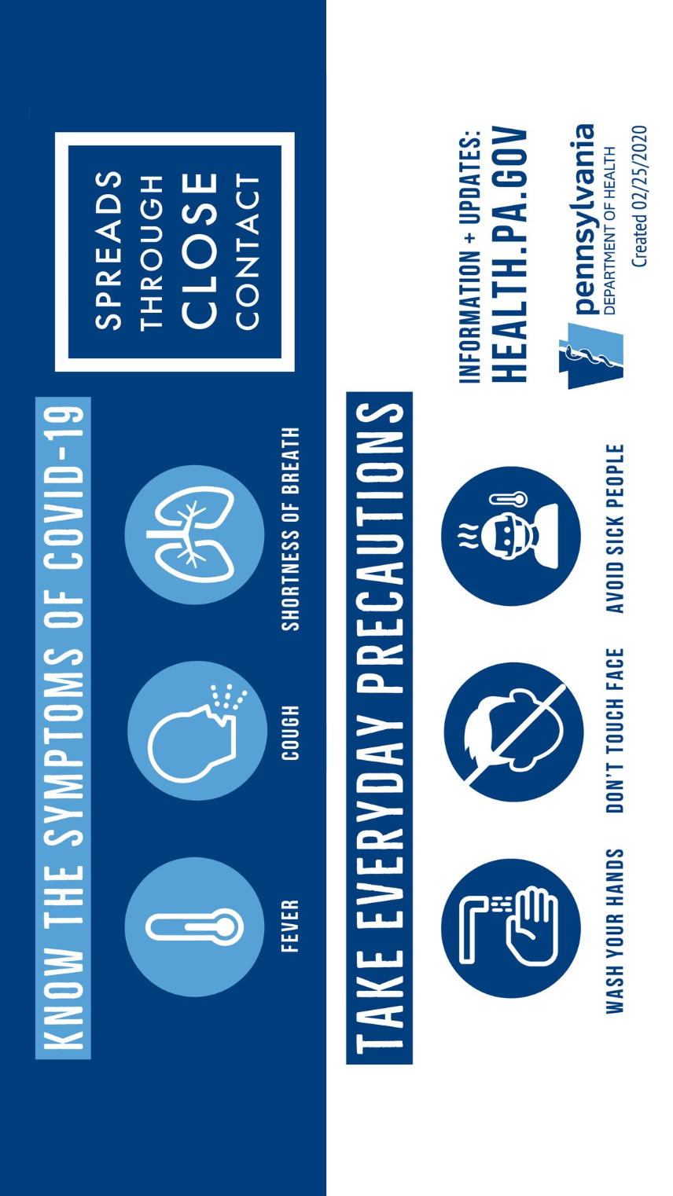

Slide 5


Did You Wash Your Hands?

Slide 6

Yinz
Worsh?

Slide 7


