Slide 1
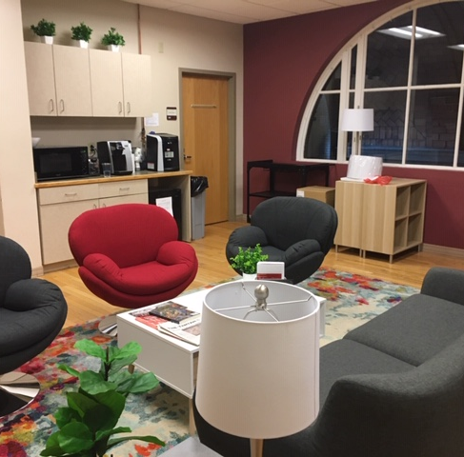
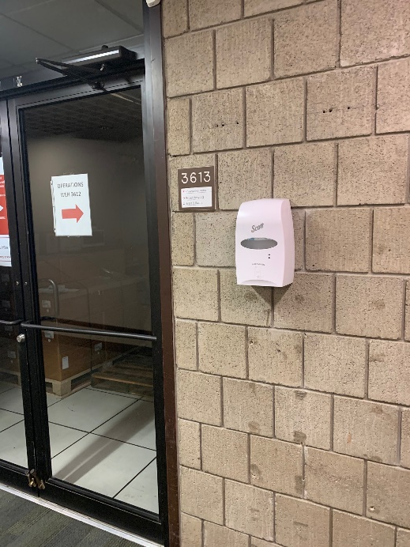
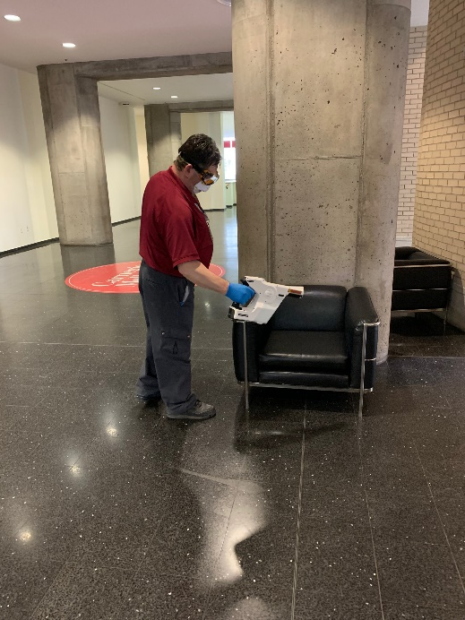
Routine Daily Sanitation and Disinfection
Electrostatic spray for occupied spaces
Time clock wipe down (every shift)
Breakrooms & common spaces
Corridors
Bathrooms
Wiping down of all high touch points
Monitor 160+ hand sanitizer locations – continued installation of wall mounted where needed

Slide 2
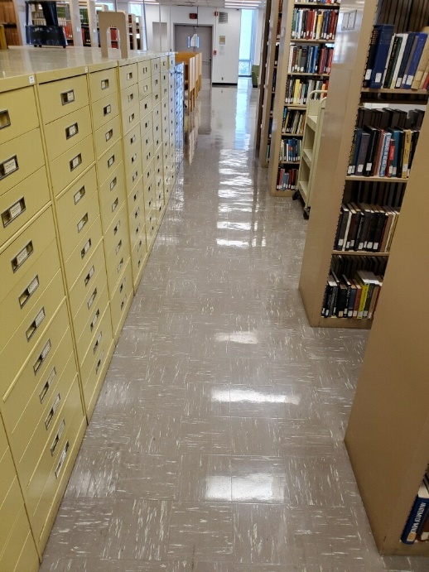
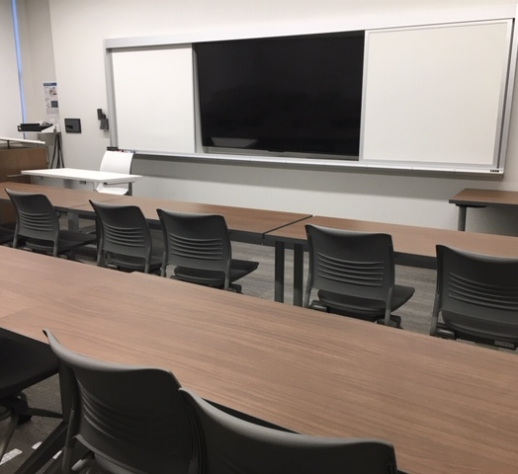
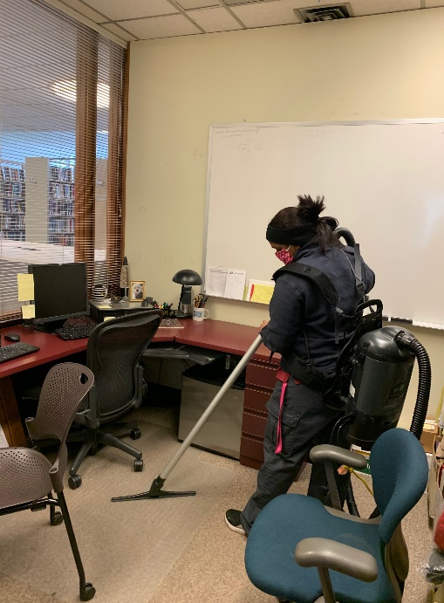
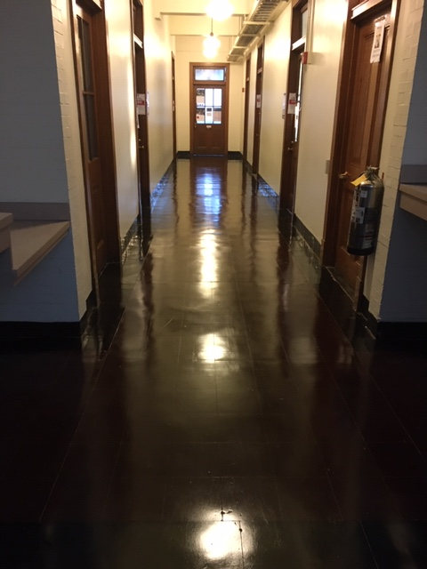
Deep Cleaning
Walls / Boards
Furniture
Upholstery cleaning
Doors and door frames
Carpet cleaning & extraction
Refinishing floors
Dining locations (cleaned at the time of the deep clean for bldg.)

Slide 3
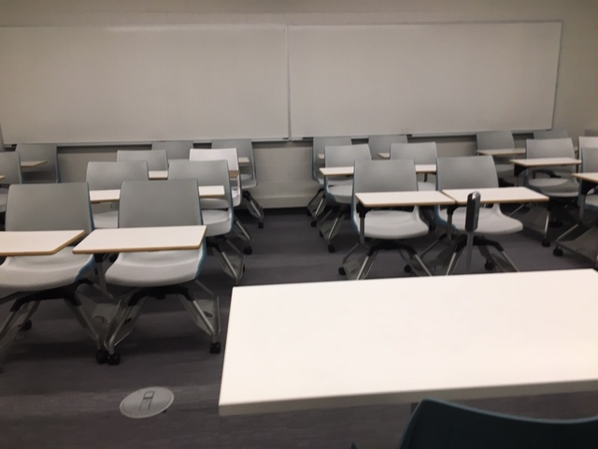
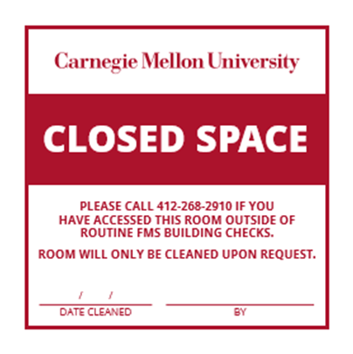
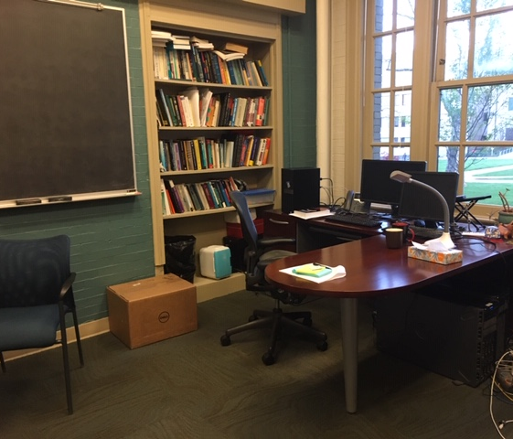
Closed Spaces
Sign placed on door –post it note style
Date of deep clean
Name of custodian
FMS will enter for visual observation / building check
If staff/faculty access the area, must call to have space re-cleaned
FMS will create new work order for re-cleaning if space is disturbed for maintenance or repair

