Slide 1

The Climate Action Working Group

Slide 2
It is time for Carnegie Mellon to formally assess Climate Action progress to-date and consider new strategies that push the campus towards carbon neutrality
Notes:
SARAH
Speak to recent outreach and publicity related to VUR and SDGs
Q&A – 5 minutes

Slide 3
Comparison of Peer Emission Reporting (Net Emissions Per Student)
Through the work of numerous campus stakeholders, Carnegie Mellon has reduced campus greenhouse gas emissions by more than 70% in comparison to the 2005 baseline.
*Source: https://unhsimap.org/public/emissions

Slide 4
With a goal of transparency and participation…
The Sustainability Initiative will form a Climate Action Working Group to develop comprehensive recommendations to identify short and long term opportunities that will materially reduce the impact of university greenhouse gas emissions.
Notes:
SARAH
Speak to recent outreach and publicity related to VUR and SDGs
Q&A – 5 minutes

Slide 5
To identify and eliminate energy waste
we need your support and insight.
Help Close This Gap
Notes:
SARAH
Speak to recent outreach and publicity related to VUR and SDGs
Q&A – 5 minutes

Slide 6

Winter Break
Energy Waste
~
~
Notes:
SARAH
Speak to recent outreach and publicity related to VUR and SDGs
Q&A – 5 minutes

Slide 7
Many of your department spaces are always available during the semester to support students and faculty
The 'always on' level of service may not be prudent over the break
Help us understand how your spaces will be used from 12/23 to 1/2/23
Notes:
SARAH
Speak to recent outreach and publicity related to VUR and SDGs
Q&A – 5 minutes

Slide 8
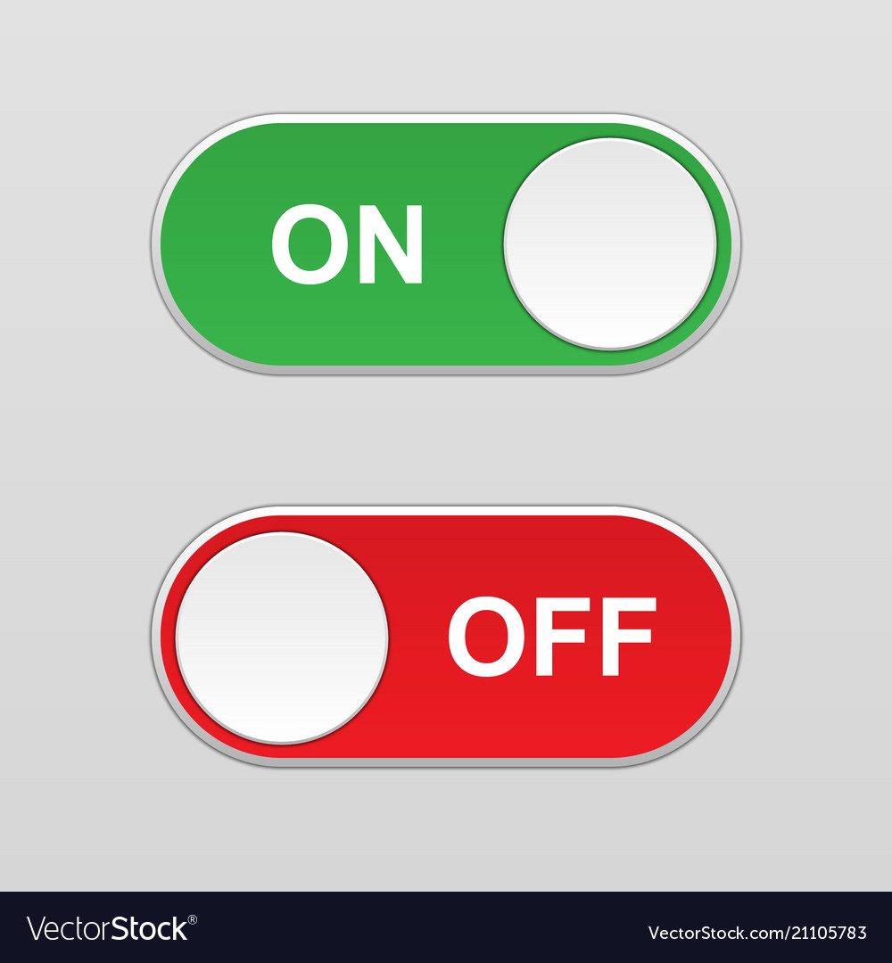
In research or critical spaces, we will default to keeping systems ON and operating normally
All other areas, we will default to closed and operating with an unoccupied setback temperature (not OFF)
SET
BACK
Notes:
SARAH
Speak to recent outreach and publicity related to VUR and SDGs
Q&A – 5 minutes

Slide 9
Suggestions on How to Provide Feedback
Example
Administration Buildings
Example Research or
Critical Space
Example
VIP or
Students
WHAT’S
ON
…we will put everything else on setback
WHERE TO SETBACK
…we will leave everything else as normal
FULL STORY
…we will follow your instructions

Slide 10
What to Expect From Us…
Weekly countdown reminders to target energy waste
Proactive communication from Zone Managers
Links to helpful checklists (remember to unplug those electronics)
Updates based on weather
Thanks for helping to reduce our footprint and financial waste
Notes:
SARAH
Speak to recent outreach and publicity related to VUR and SDGs
Q&A – 5 minutes

