Slide 1
Construction Related Steam Outage
Highmark Health & Wellness
Scaife Hall
Meeting Purpose:
Briefing on 48 Hour Steam Outage
Agenda
Scope of Work
Buildings Affected
Services Impacted
Next Steps

Slide 2
Steam Outage Starts – Noon on Tuesday, August 15
Steam Outage Ends – Noon on Thursday, August 17

Slide 3
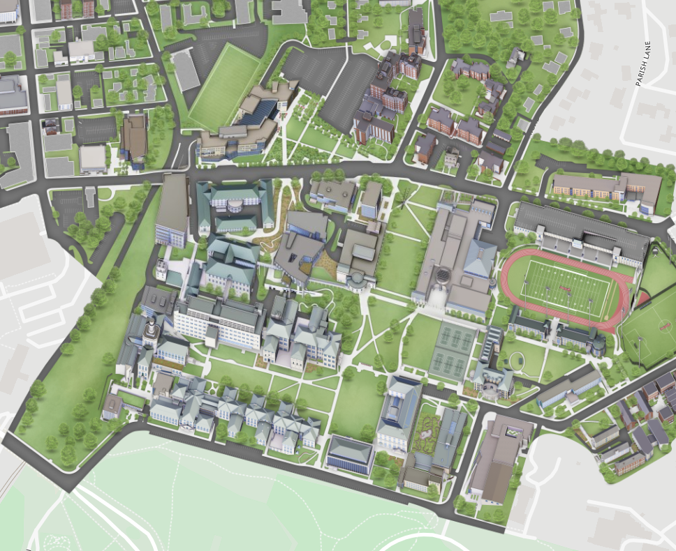
Steam Outage Starts – Noon on Tuesday, 8/15 Steam Outage Ends – Noon on Thursday, 8/17
Services Impacted During Outage
HVAC adjustments in all buildings
Domestic hot water will be off
Dining locations w/o hot water
  Posner Hall
  NSH
  Wean
  Gates
  CFA
Heating for CUC pool will be off
Services NOT Impacted
Housing buildings
Domestic hot water in CUC
Domestic hot water in Tepper
Domestic hot water in Hunt Library
Domestic hot water in Purnell

