Slide 1
Planned Building Power Outages
Electrical Equipment Testing and Maintenance
Meeting Purpose:
Briefing on Planned Power Outages for Electrical Testing and Maintenance
Agenda
Scope of Work
Buildings Affected
Calendar Review
Next Steps

Slide 2
Electrical Equipment Testing & Maintenance in January 2023
8 Hour Power Outages - Emergency Power will be ACTIVE for the Duration
First of three meetings / briefings
Intended to start information exchange
Required testing and maintenance on main electrical equipment
Testing in January allows us to perform repairs in after commencement

Slide 3
Electrical Equipment Testing & Maintenance in January 2023
8 Hour Power Outages - Emergency Power will be ACTIVE for the Duration
The testing and maintenance will require building power outages
The target week for the work is January 8
The work and outages are weather dependent. Very cold weather will cancel
Current planning duration for a typical building outage is 8 hours

Slide 4
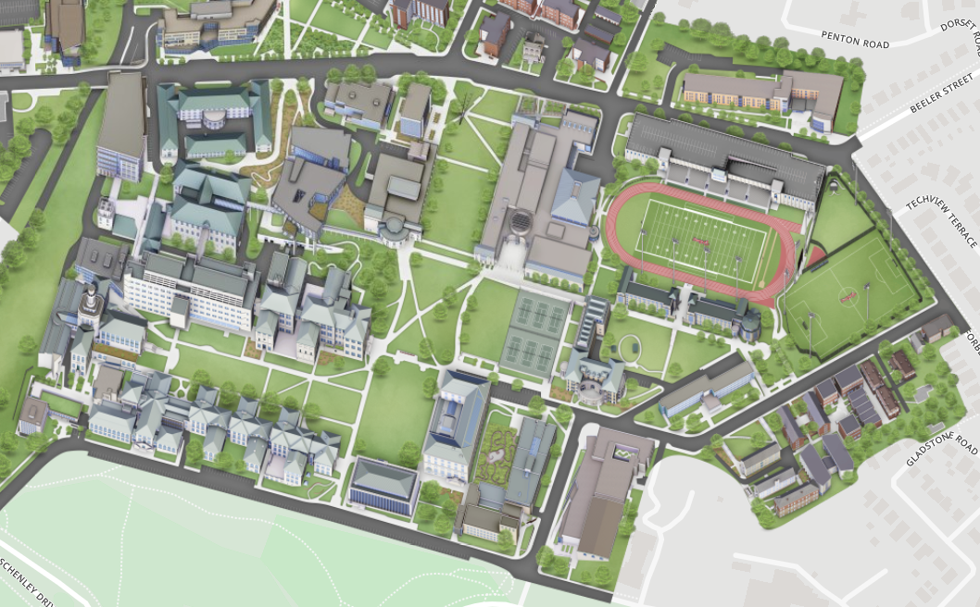
Buildings Identified for 8 Hour Power Shutdown
Doherty Hall
FMS Building
Gates Hillman Center
Hamburg / Smith Hall
Hamerschlag Hall
RMCIC
Newell Simon Hall
Purnell Center
Tepper Building

Slide 5
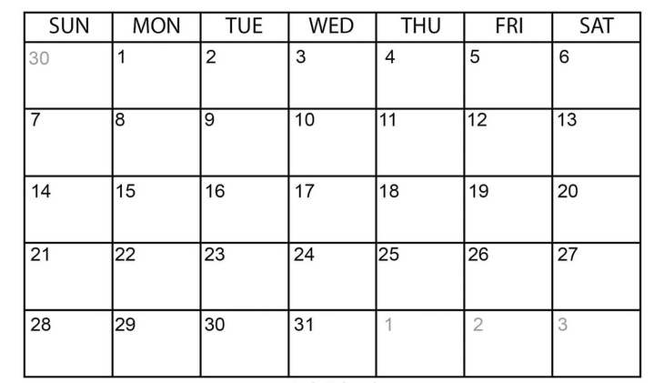

January 2024
Target Dates
8 Hour Power Shutdowns
Week of January 8
Winter Break - ends January 3
Fall Semester Starts – January 16

Slide 6
Planned Building Power Outages Week of January 8
Next Steps for Department Representatives:
Be aware that building power outages are being planned
Start collecting questions or concerns
Provide feedback on any conflicts for week of January 8
  for example 'major conference planned'
Requesting preliminary feedback, no later than 10/31/2023
Next planning update will be 11/15/2023
Final planning update will be 12/15/2023

