Slide 1
Planned Building Power Outages
Electrical Equipment Testing and Maintenance
Meeting Purpose:
Briefing on Planned Power Outages for Electrical Testing and Maintenance
Agenda
Overview
Buildings Affected – updated based on feedback
Duration and Weather
Communication
Next steps

Slide 2
Electrical Equipment Testing & Maintenance in January 2024
Planned Power Outages - Emergency Power will be ACTIVE for the Duration
Thank you for feedback
Required testing and maintenance on main electrical equipment
Testing in January allows us to perform repairs after Commencement
The testing and maintenance will require building power outages
The work and outages are weather dependent

Slide 3
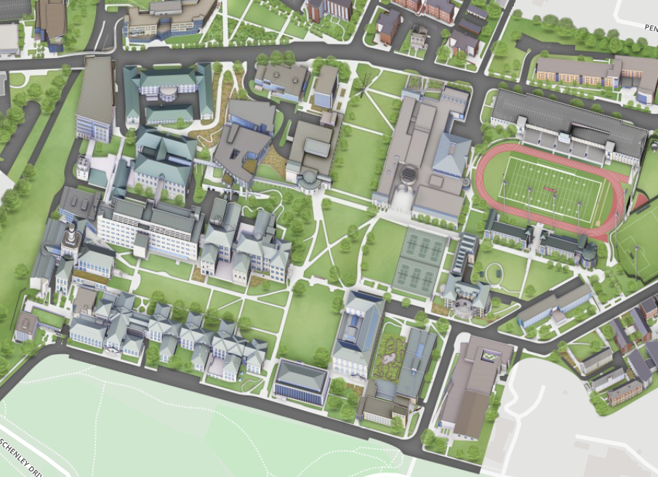
Buildings Identified for January Power Shutdown
January 10
Hamburg / Smith Hall
Newell Simon Hall
FMS Building
January 11
Doherty Hall
Gates Hillman Center
Purnell Center

Slide 4
Expected Duration and Weather
Planning 8 hours for power outage
Building preparation starts before outage
The work is weather dependent
Cancel if expected daytime temperatures < 28
Work does not start until actual temperature > 20
Start time for building preparation ~7AM
Start time for power outage ~8:30AM

Slide 5
Communication During Work
Email updates will be sent to FMS Announce d-lists
24 hours in advance with weather update
Start of building preparations
At time of power outage
At time power is restored
Questions During
Call FMS Service Response Center 412.268.2910

Slide 6
Planned Building Power Outages Week of January 8
Next Steps for Department Representatives:
Be aware that building power outages are being planned
Buildings will be CLOSED during power outages
Continue discussion with FMS staff on your departments needs
Provide any new feedback. Send email to Shannon

