Slide 1
The Cut to Purnell Steam and Water Line Replacement Project
Water Line Shut Down Coordination
May 23, 2024

Slide 2
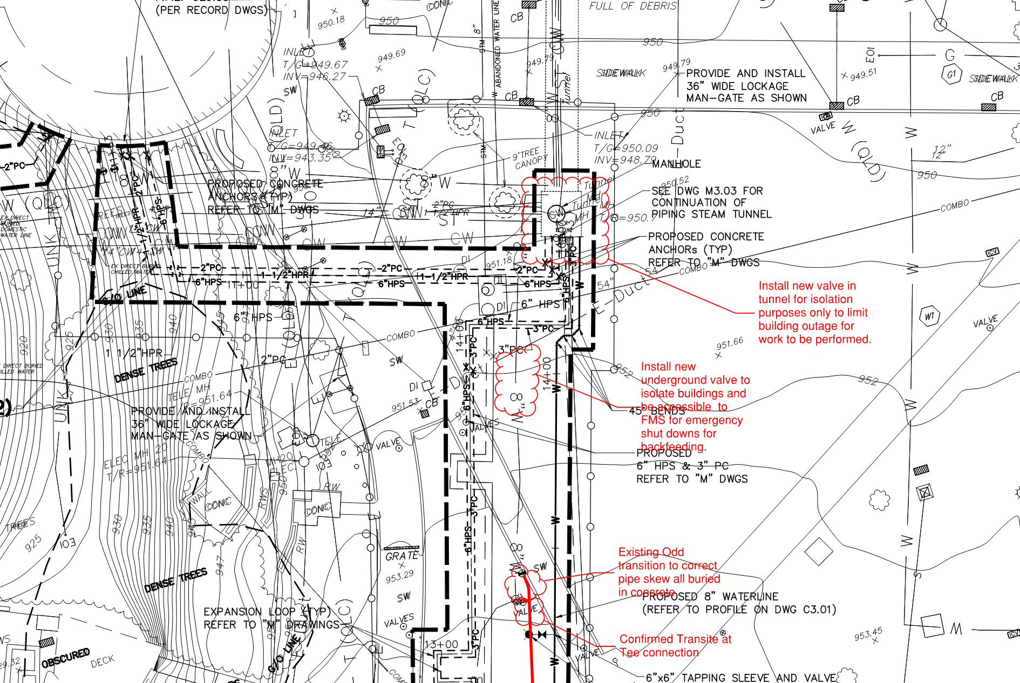
SCOPE
PURNELL CENTER
CUC
Goal to avoid unplanned interruptions to water service during the water line replacement project.
During the outage, the team will be installing a new isolation valve in the TTNW South Vault, which will help Campus isolate Gates, Purnell & CUC , so as to avoid interruptions.
GATES

Slide 3
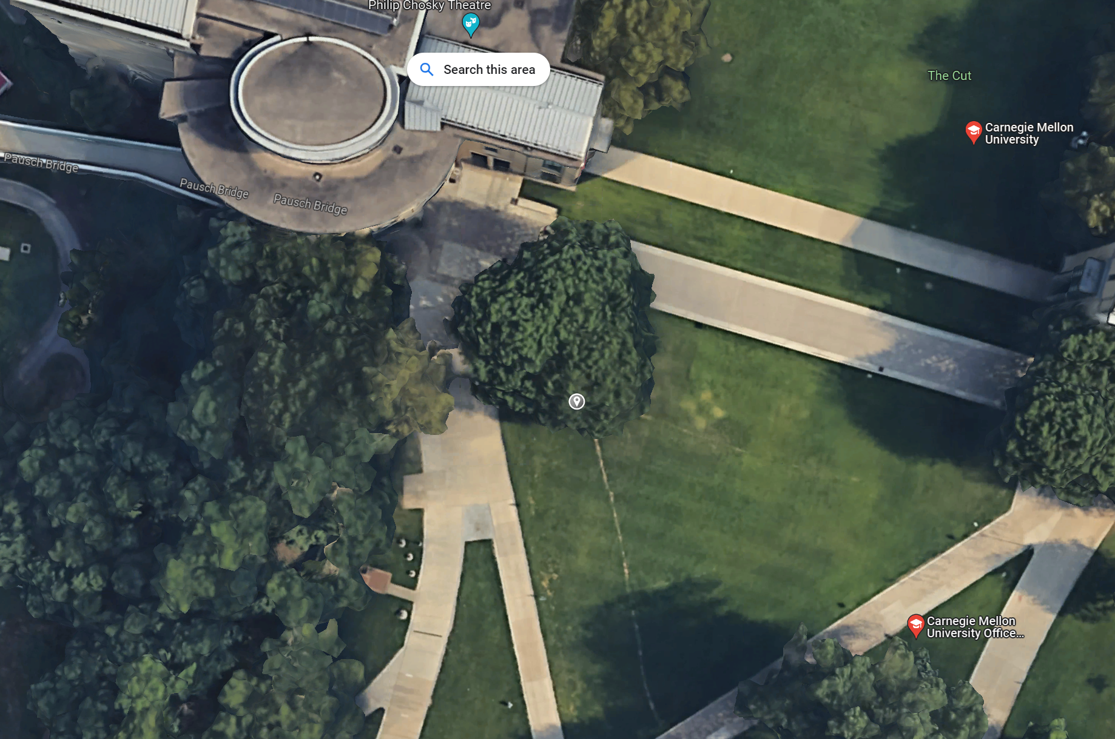
SCOPE
Goal to avoid unplanned interruptions to water service during the water line replacement project.
During the outage, the team will be installing a new isolation valve in the TTNW South Vault, which will help Campus isolate Gates, Purnell & CUC , so as to avoid interruptions.
Install new isolation valve in the TTNW S Vault

Slide 4
PROPOSED SCHEDULE – WED, May 29, 2024 – THURS, May 30, 2024
Water Shut Off For Draining – 6 PM
Once water pipes and hydrant is drained, new work for the isolation valve will commence between 6PM and 5AM.
Water will be re-energized post this time, for water service to buildings.
Recommended that buildings remain unoccupied during this time as this line impacts fire suppression systems as well.

Slide 5
CONTACT INFORMATION
Salonika Garapaty CDFD Project Manager sgarapat@andrew.cmu.edu
Chris Deely CDFD Project Associate cdeely@andrew.cmu.edu
Andrew Reilly CDFD Sr. Director of Construction areilly@cmu.edu
Ron Cunningham FMCS, Director rcunning@andrew.cmu.edu
Mark Jones FMCS , Plumbing msjones@andrew.cmu.edu
QUESTIONS

