Slide 1
Steam and Water Line Replacement Project
The Cut to Purnell
Facility Coordinator Meeting
April 24, 2024

Slide 2
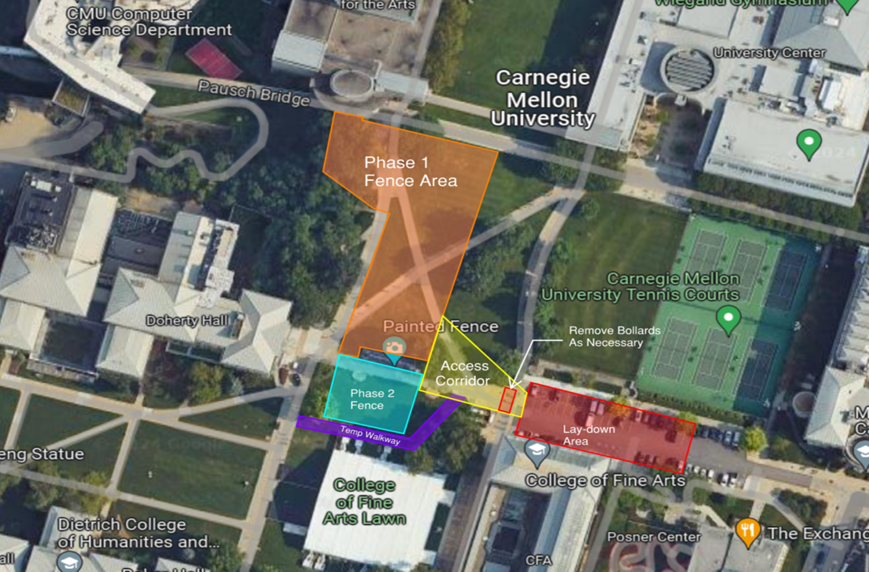
PROJECT SCOPE
Replacement of approx. 650 LF of Direct Buried Steam and Condensate Lines between the Main Tunnel and Purnell Center.
Project will also be replacing approximately, 450 LF of Water Lines in the same vicinity.
Project includes mechanical work in Purnell Center mechanical room and new condensate piping down the Purnell hillside.

Slide 3
SCHEDULE
Early Mobilization for Interior Work in Tunnel & Purnell Mechanical Room – April 2024
Site Work and Excavation – May 2024 ( Post Commencement Activities)
Installation of Steam and Water Line Piping – June 2024 to July 2024
Main Campus Steam Shutdown (72 Hours) – June 4 to June 6, 2024
Backfill and Landscaping – July 2024 to August 2024

Slide 4
Meeting Purpose:
Briefing on Planned 72-hour Steam Outage
for Construction and Maintenance Work
Overview
Buildings and systems affected
Communication and next steps

Slide 5
Briefing on Planned 72-hour Steam Outage
for Construction and Maintenance Work
Thank you for feedback
Outage required for construction and maintenance
Work requires full campus steam outage for 72 hours

Slide 6
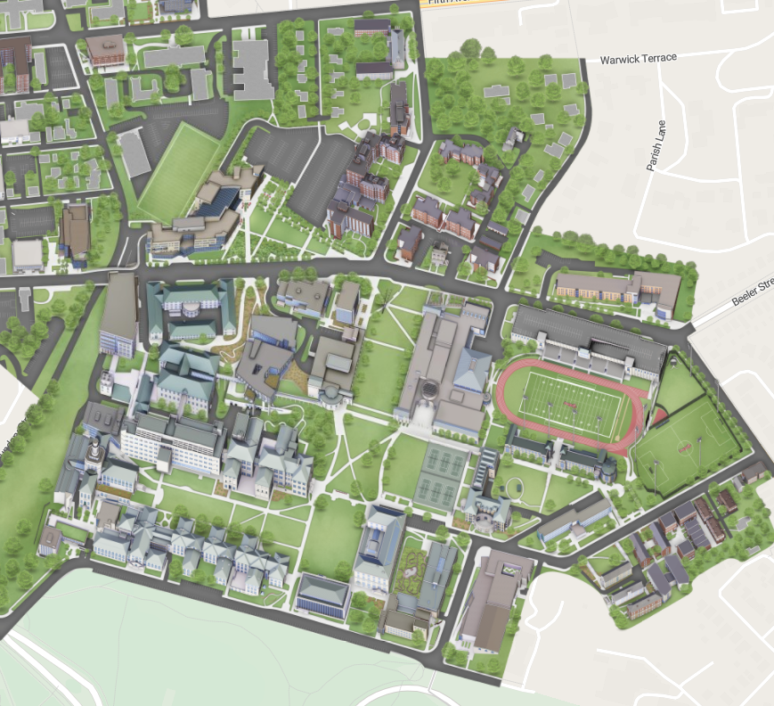
Buildings Connected to the Steam System
Academic
Administrative
Athletic
Dining
Housing
Research

Slide 7
Impacts to Building Services
Potentially Affected
Domestic hot water
HVAC temperatures
HVAC humidity
NOT Affected
Systems with backup
Housing Buildings
Hot water in CUC
Hot water in Tepper
Spaces with historic HVAC

Slide 8
Expected Duration
Planning for 72-hour outage
Morning: Tuesday, June 4
Afternoon: Thursday, June 6

Slide 9
Next Steps for Department Representatives:
Be aware that 72-hour steam outage is planned
Buildings will be OPEN during steam outage
Contact FMS Zone staff on your departments needs
Provide feedback to Shannon Wetzel by May 17

