Slide 1
Planned Building Power Outages
Electrical Equipment Testing and Maintenance
Meeting Purpose:
Briefing on Planned Power Outages for Electrical Testing and Maintenance
Agenda
Overview
Buildings Affected – updated based on feedback
Duration and Weather
Communication
Next steps

Slide 2
Electrical Equipment Testing & Maintenance in June 2024
Planned Power Outages - Emergency Power will be ACTIVE for the Duration
Thank you for feedback
Required testing and maintenance on main electrical equipment
The testing and maintenance will require a full building power outage
The work and outages are weather dependent

Slide 3
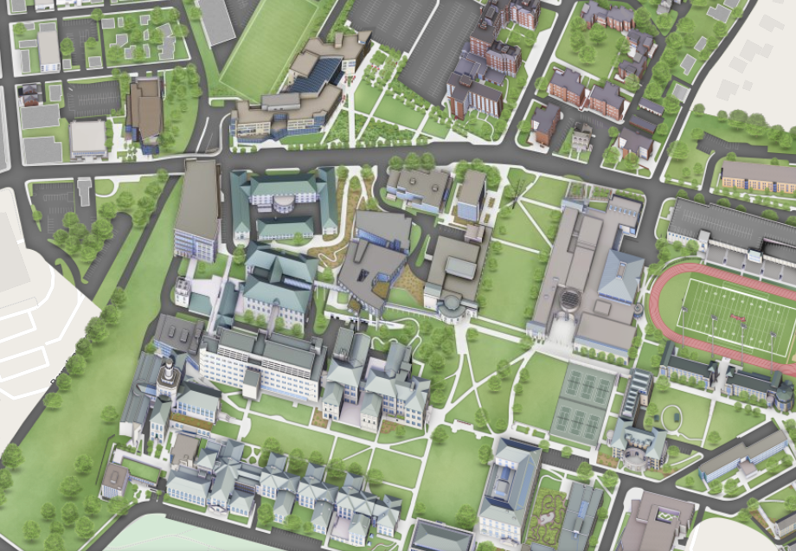
Buildings Identified for June Power Shutdown
Target Date - June 19
  Tepper Building
  CIC Building

Slide 4
Expected Duration and Weather
Planning 8 hours for power outage
  Building preparation starts before outage
The work is weather dependent
  Cancel if potential flooding
  Cancel if extreme heat
Start time for building preparation ~7AM
Start time for power outage ~8:30AM

Slide 5
Communication During Work
Email updates will be sent to FMS Announce d-lists
  24 hours in advance with weather update
  Start of building preparations
  At time of power outage
  At time power is restored
Questions During
  Call FMS Service Response Center 412.268.2910

Slide 6
Planned Building Power Outages Week of June 19
Next Steps for Department Representatives:
Be aware that building power outages are being planned
Buildings will be CLOSED during power outages
Continue discussion with FMS staff on your departments needs
Provide any new feedback. Send email to Shannon

