Slide 1
The Cut to Purnell Steam and Water Line Replacement Project
Steam Shutdown July 9- July 10, 2024
June 27, 2024

Slide 2
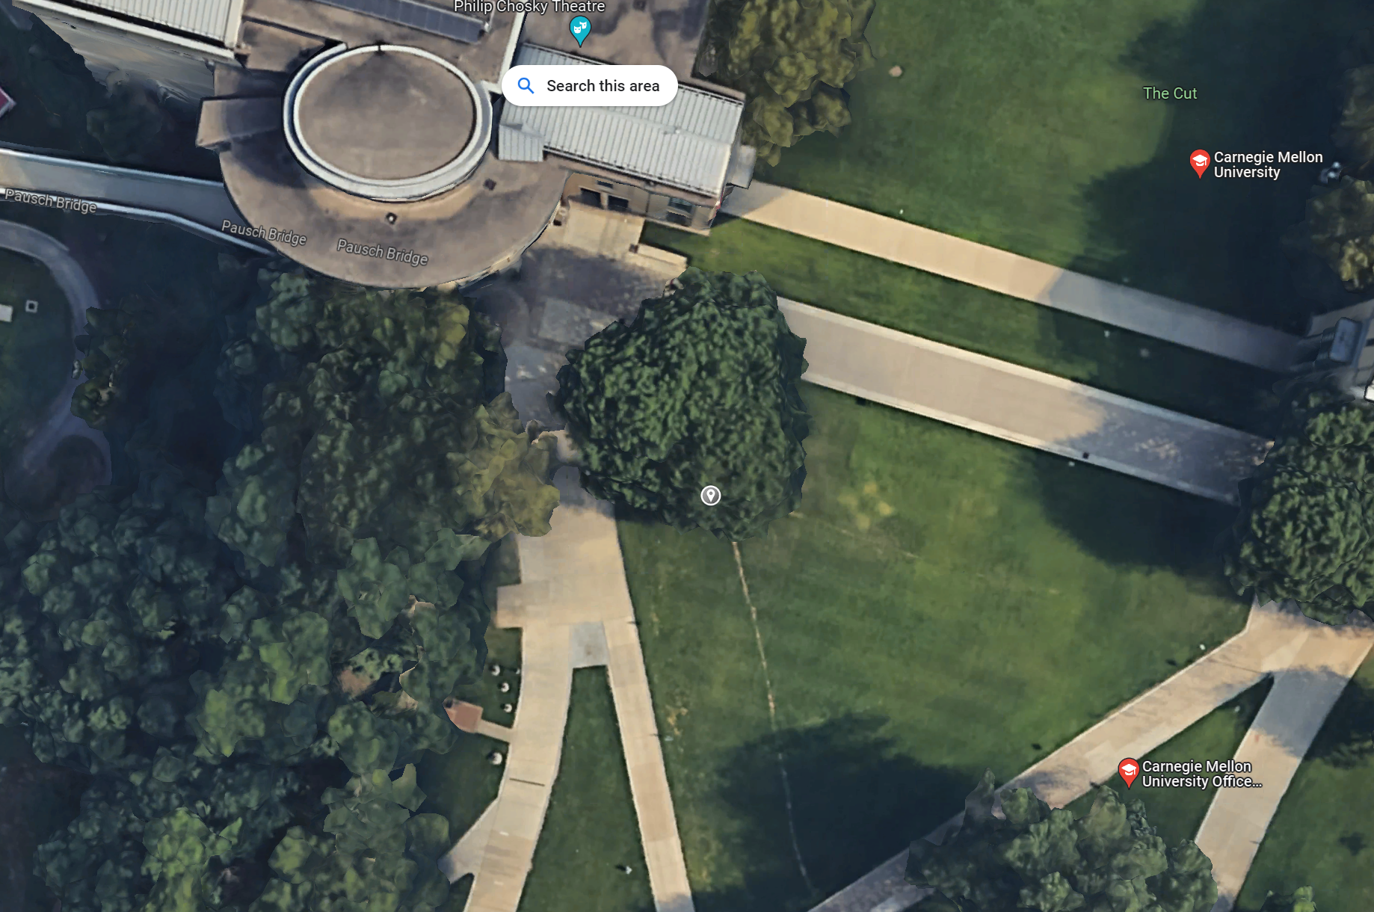
SCOPE
Isolate Valves in the Tunnel to No Where North Vault – to isolate Warner
Isolate valves in the Purnell Mechanical Room
Install temporary valves in TTNW and complete installation of new piping and valves in Purnell Mechanical room.
Impacted Buildings- Cyert Hall, Warner Hall and Purnell Center.
Demolish old line going to Purnell, and isolate with new valves

Slide 3
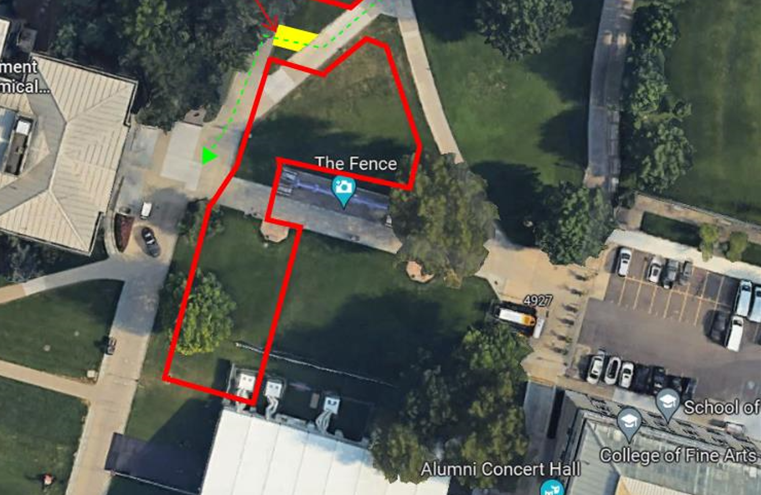
SCOPE
Isolate Valves in the Main Tunnel
Demolish old line, run new piping to the tie in location within the Main Tunnel
Impacted Buildings - East Campus – CFA, MMCH, Hunt Library, CUC, Posner , HOA , HHW
Valve Shutdown in Main Tunnel

Slide 4
PROPOSED SCHEDULE
TUE, July 9, 2024 – WED, July 10, 2024
Steam Shutoff Start Time – 6:00 AM
Steam will be re-energized – prior to 7:00 AM on Wednesday, July 10, 2024.
Impacts to building steam will be similar to the impacts during the Campus Steam Shutdown that was conducted earlier in June 2024.

Slide 5
CONTACT INFORMATION
Salonika Garapaty CDFD Project Manager sgarapat@andrew.cmu.edu
Chris Deely CDFD Project Associate cdeely@andrew.cmu.edu
Andrew Reilly CDFD Sr. Director of Construction areilly@cmu.edu
Joe Hursen FMCS, Utilities Manager jhursen@andrew.cmu.edu
QUESTIONS

