Slide 1
Planned Campus Steam Outage
Central Utilities Testing and Maintenance
Meeting Purpose:
Briefing on Planned 72-hour Steam Outage for Maintenance
Agenda
Scope of Work
Buildings Affected
Calendar Review
Next Steps

Slide 2
72 Hour Planned Campus Steam Outage
This is the only meeting / briefing
Intended to facilitate information exchange
Asking for feedback by end of week – Friday, July 18, 2025

Slide 3
72 Hour Planned Campus Steam Outage
The testing and maintenance will require steam outage on main campus
Outage will last 72 hours
The target timeframe starts Thursday, July 31 or Friday, August 1
  Thursday start ensure finish before Monday
  Friday start creates risk for Monday

Slide 4
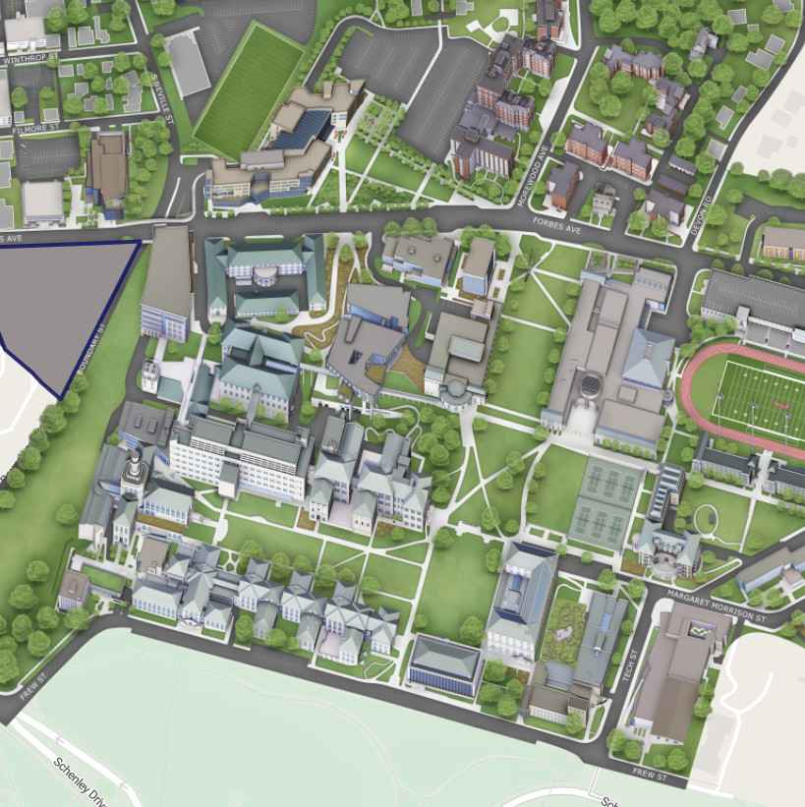

Buildings
In Redline Area
Will Be Affected

Slide 5

All Buildings
Will Have Air Conditioning
Temperatures may be cooler than normal
HVAC Mechanics will make adjustments

Slide 6

Building
Will Have Domestic
Hot Water
CUC, Highmark, and Tepper

