Slide 1
Planned Campus Steam Outage
This is the only meeting / briefing
Intended to facilitate information exchange
Asking for feedback by Wednesday, September 10, 2025

Slide 2
The outage WON’T be on October 4

Slide 3
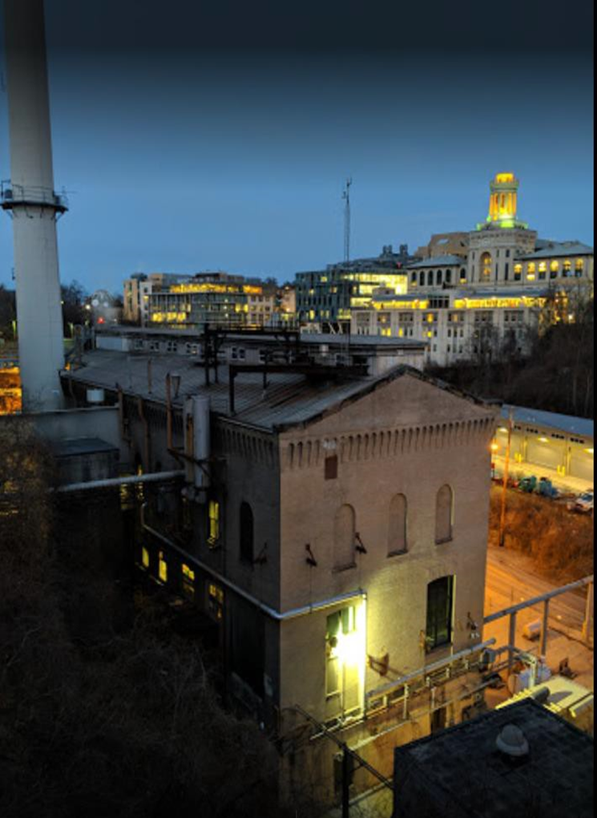
8 Hour Campus Steam Outage
BBP emergency repair
Requires steam outage on main campus
Outage will last 8 hours
Potential dates:
Saturday, September 20
Saturday, October 11
Fall Break (10/14, 10/15, or 10/16)
Timeframe: 6AM to 2PM
Bellefield
Boiler Plant (BBP)

Slide 4
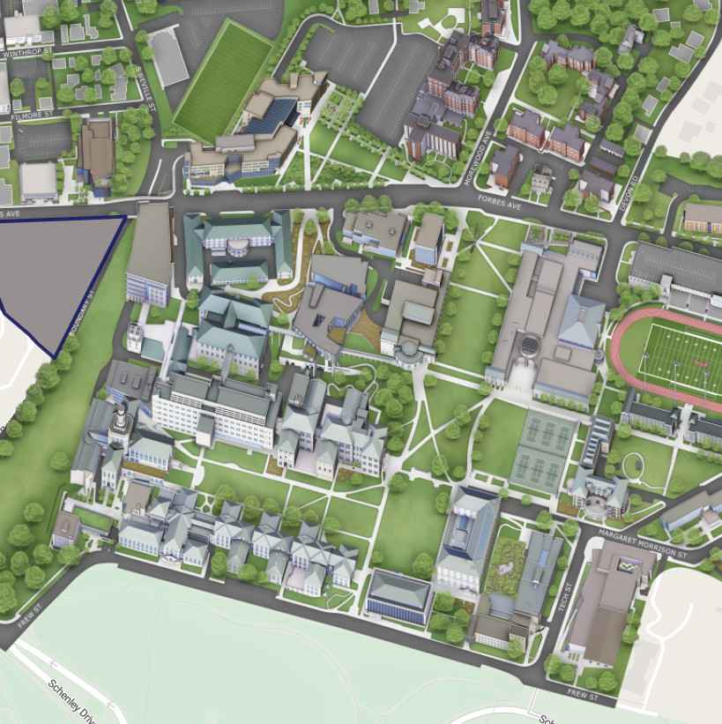

Buildings
In Redline Area
Will Be Affected

Slide 5

Building
Will Have Domestic
Hot Water
CUC, Highmark, and Tepper

Slide 6

All Buildings
Will Have Air Conditioning
Temperatures may be cooler than normal
HVAC Mechanics will make adjustments

Slide 7
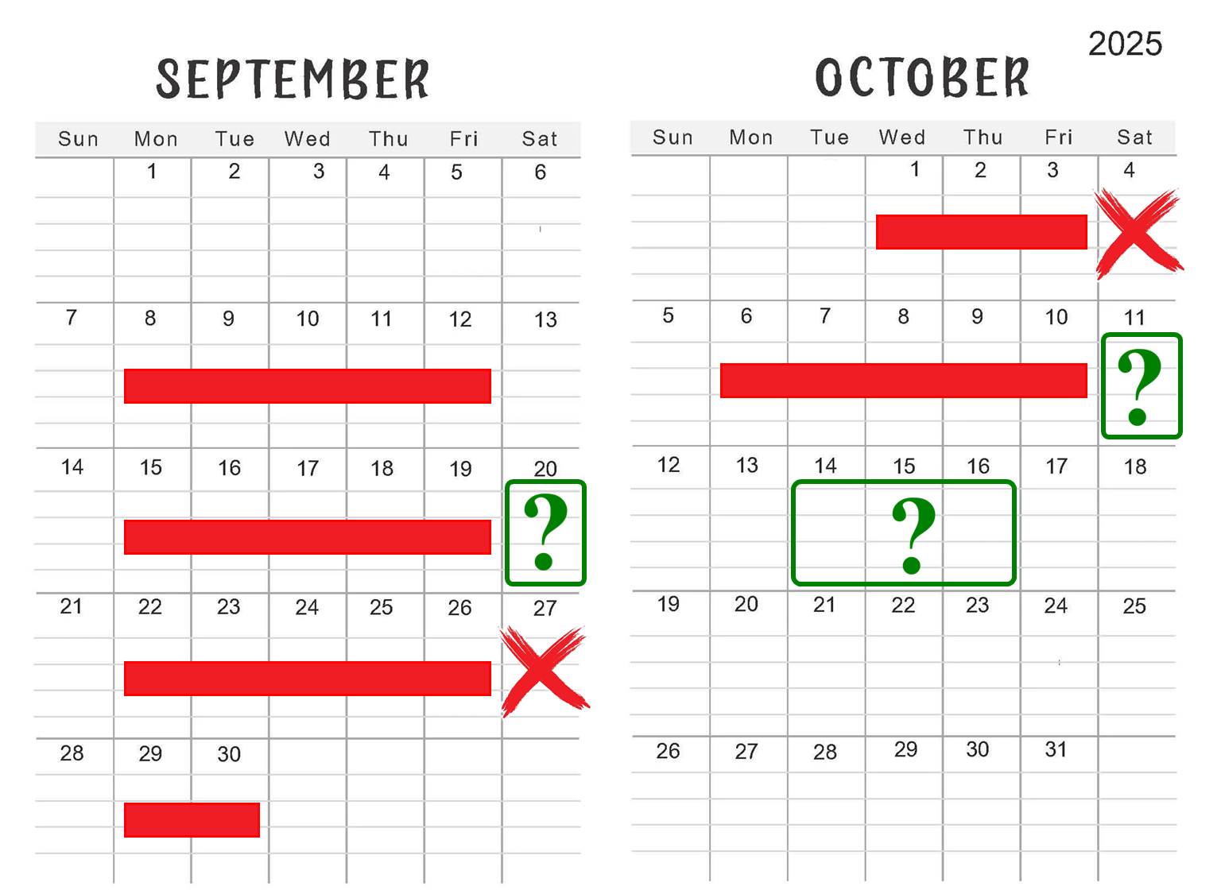

Slide 8
8 Hour Campus Steam Outage
BBP emergency repair
Requires steam outage on main campus
Outage will last 8 hours
Potential dates:
Saturday, September 20
Saturday, October 11
Fall Break (10/14, 10/15, or 10/16)
Timeframe: 6AM to 2PM
Feedback by Wednesday, September 10
Bellefield
Boiler Plant (BBP)

Slide 9
